Slide 1
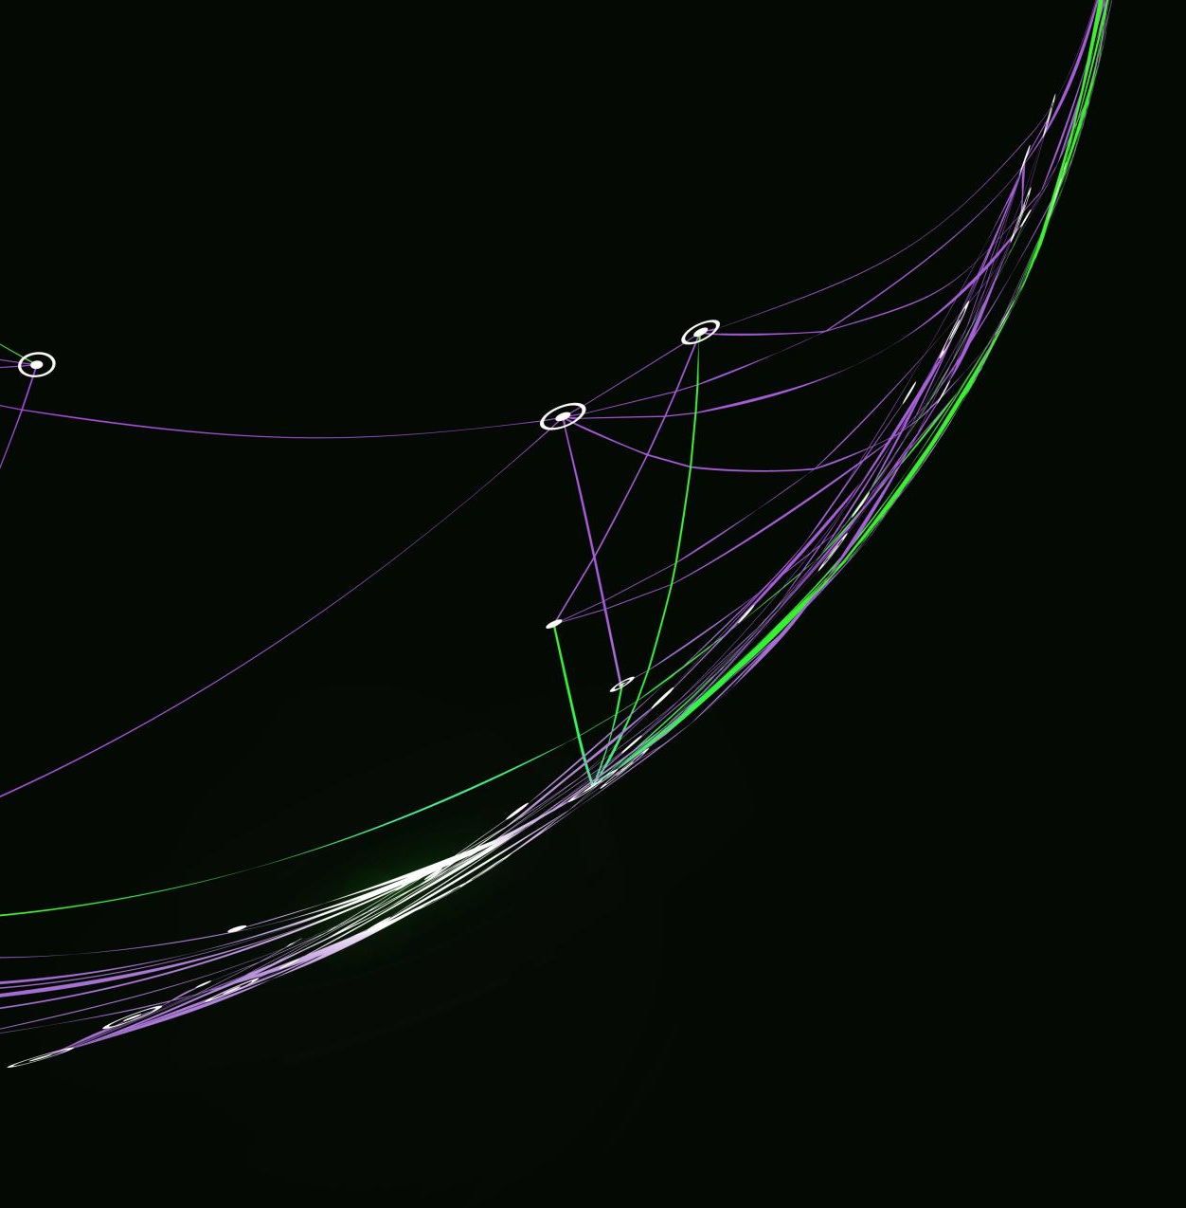
Project Management
Agile and Waterfall model

Slide 2
Advantages of Using Formal Project Management
Better control of financial, physical, and human resources
Improved customer relations
Shorter development times
Lower costs
Higher quality and increased reliability
Higher profit margins
Improved productivity
Better internal coordination

Slide 3
What Is a Project?
A project is “a temporary endeavor undertaken to create a unique product, service, or result”
Projects end when their objectives have been reached or the project has been terminated
Projects can be large or small and take a short or long time to complete
Project Attributes:
has a unique purpose
is temporary
requires resources, often from various areas
should have a primary customer or sponsor
The project sponsor usually provides the direction and funding for the project

Slide 4
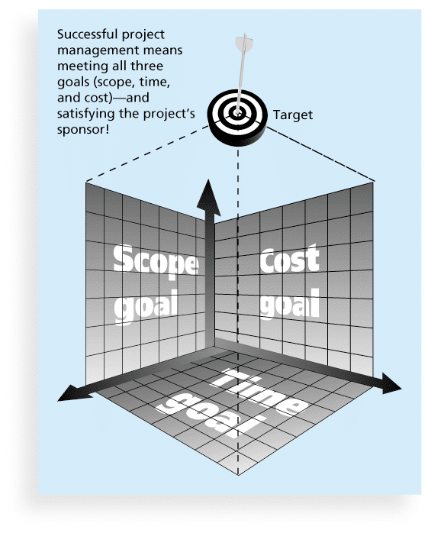
The Triple Constraint
Every project is constrained in different ways by its
scope, time and cost goals.
Scope: What is the project trying to accomplish? What unique product or service does the customer or sponsor expect from the project ?
Time: How long should it take to complete the project? What is the project schedule ?
Cost: What should it cost to complete the project?

Slide 5
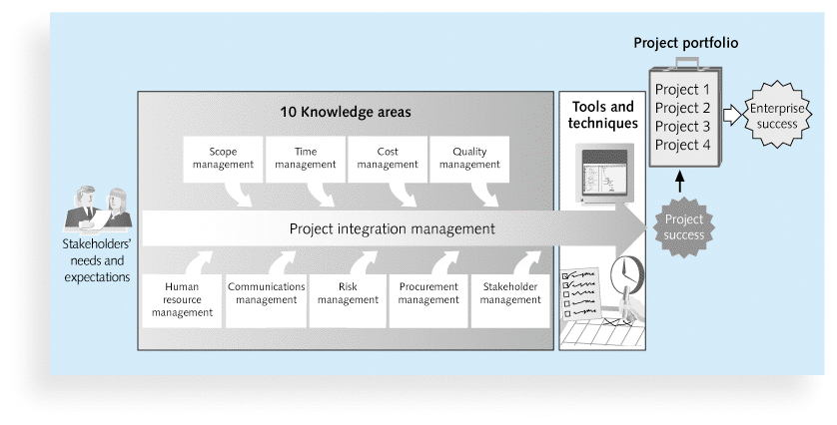
What is Project Management?
Project management is “the application of knowledge, skills, tools and techniques to project activities to meet project requirements”
The art of organizing, leading, reporting and completing a project through people
Project managers strive to meet the triple constraint (project scope, time, and cost goals) and facilitate the entire process to meet the needs and expectations of project stakeholders

Slide 6
Project Stakeholders
Stakeholders are the people involved in or affected by project activities
Stakeholders include:
the project sponsor
the project manager
the project team
support staff
customers
users
suppliers
opponents to the project
Stakeholder Engagement process:
Identify Stakeholders
Assess needs
Define actions
Establish communication channels
Gather feedback
Monitor and review
Stakeholders
Sponsor
Project manager
Project team
Support staff
Customers
Users

Slide 7
10 Project Management Knowledge Areas
Knowledge areas describe the key competencies that project managers must develop
Project managers must have knowledge and skills in all 10 knowledge areas (project integration, scope, time, cost, quality, human resource, communications, risk, procurement, and stakeholder management)

Slide 8
Project Success
There are several ways to define project success:
The project met scope, time, and cost goals
The project satisfied the customer/sponsor
The results of the project met its main objective, such as making or saving a certain amount of money, providing a good return on investment, or simply making the sponsors happy

Slide 9
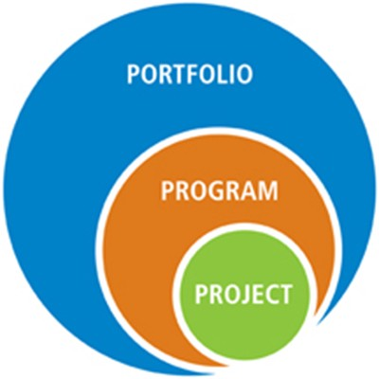
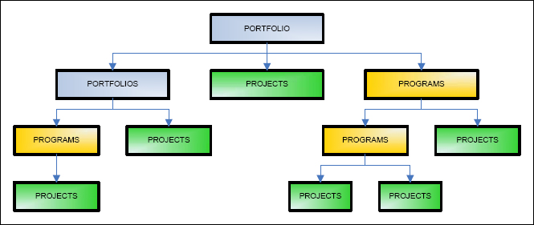
Project, Program, and Portfolio
Project managers work with project sponsors, project team, and other people involved in a project to meet project goals
Program: group of related projects managed in a coordinated way to obtain benefits and control not available from managing them individually
Program managers oversee programs; often act as bosses for project managers
A portfolio refers to projects, programs, sub-portfolios, and operations managed as a group to achieve strategic objectives.

Slide 10
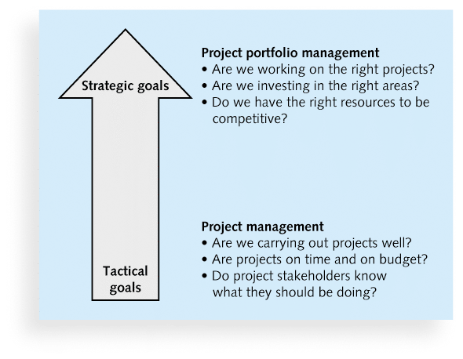
Project Portfolio Management
Project portfolio management (PPM) is the centralized management of an organization's projects. While these projects may or may not be related, they are ﻿managed under one umbrella (called a portfolio) to oversee and manage any competing resources.
Portfolio managers help their organizations make wise investment decisions by helping to select and analyze projects from a strategic perspective

Slide 11
The Role of the Project Manager
Job descriptions vary, but most include responsibilities like planning, scheduling, coordinating, and working with people to achieve project goals
Suggested Skills for Project Managers:
Project managers need a wide variety of skills.
Project managers need both “hard” and “soft” skills.
Hard skills include product knowledge and knowing how to use various project management tools and techniques, and
soft skills include being able to work with various types of people
Most Important skills for PM:
1. People skills 2. Leadership 3. Listening 4. Integrity, ethical behavior, consistent 5. Strong at building trust | 6. Verbal communication 7. Strong at building teams 8. Conflict resolution, conflict management 9. Critical thinking, problem solving 10. Understands, balances priorities

Slide 12
Importance of Leadership Skills
Effective project managers provide leadership by example
A leader focuses on long-term goals and big-picture objectives while inspiring people to reach those goals
A manager deals with the day-to-day details of meeting specific goals
Project managers often take on the role of both leader and manager
Notes:
Project management tools and techniques assist project managers and their teams in various aspects of project management
Some specific ones include
Project charter, scope statement, and WBS (scope)
Gantt charts, network diagrams, critical path analysis, critical chain scheduling (time)
Cost estimates and earned value management (cost)

Slide 13
A Systems View of Project Management
A systems approach emerged in the 1950s to describe a more analytical approach to management and problem solving
Systems are sets of interacting components that work within an environment to fulfill some purpose.
Notes:
A systems approach emerged to describe a more analytical approach to management and problem solving
Three parts include:
Systems philosophy: an overall model for thinking about things as systems
Systems analysis: problem-solving approach
Systems management: address business, technological, and organizational issues before making changes to systems

Slide 14
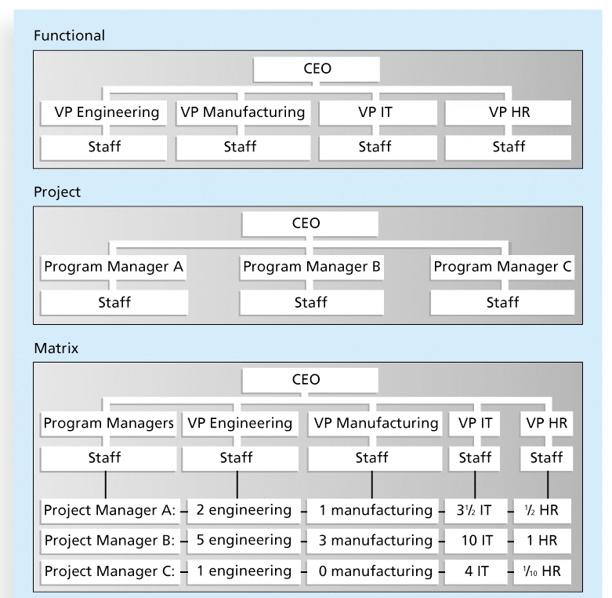
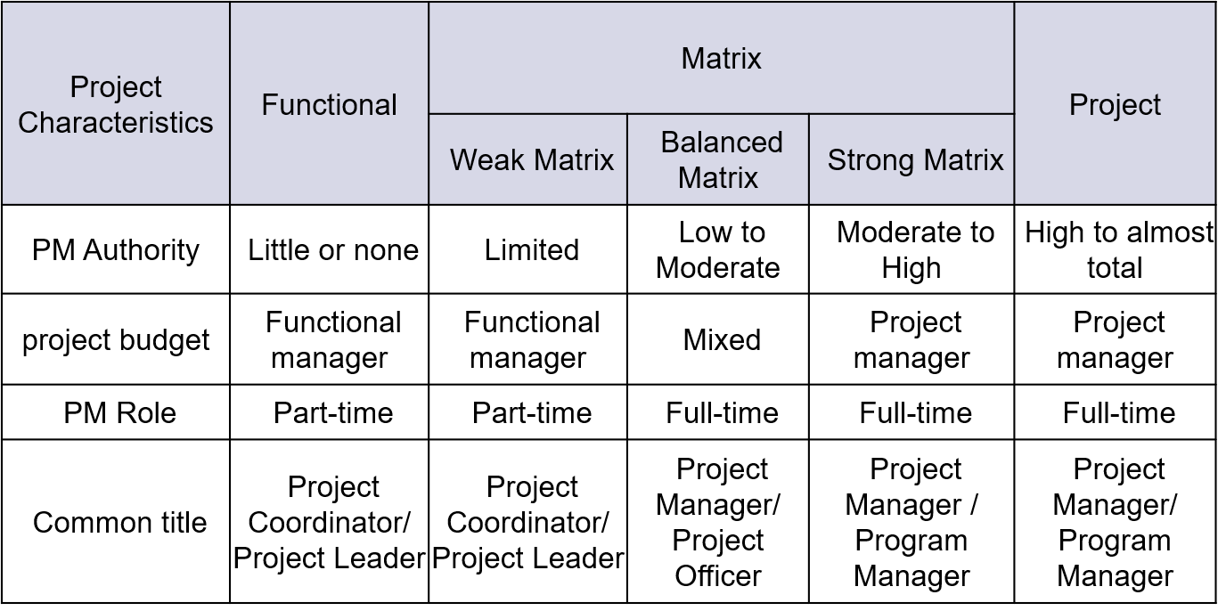
Organizational Structures
Three basic organization structures
Functional: functional managers report to the chief executive officer (CEO)
Project: program managers report to the CEO
Matrix: middle ground between functional and project structures; personnel often report to two or more bosses; structure can be weak, balanced, or strong matrix
Notes:
vp Vice President
chief executive officer (CEO),

Slide 15
Project Life Cycle
A project life cycle is a collection of project phases that defines
what work will be performed in each phase
what deliverables will be produced and when
who is involved in each phase, and
how management will control and approve work produced in each phase
A deliverable is a product or service produced or provided as part of a project

Slide 16
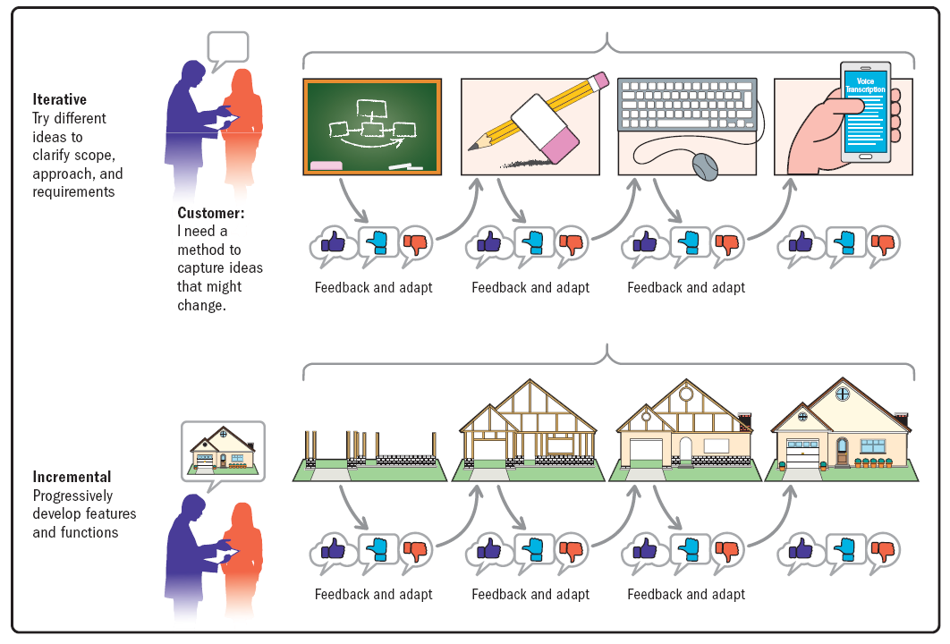
Project Phases
In early phases of a project life cycle
resource needs are usually lowest
the level of uncertainty (risk) is highest
project stakeholders have the greatest opportunity to influence the project
In middle phases of a project life cycle
the certainty of completing a project improves
more resources are needed
The final phase of a project life cycle focuses on
ensuring that project requirements were met
the sponsor approves completion of the project

Slide 17
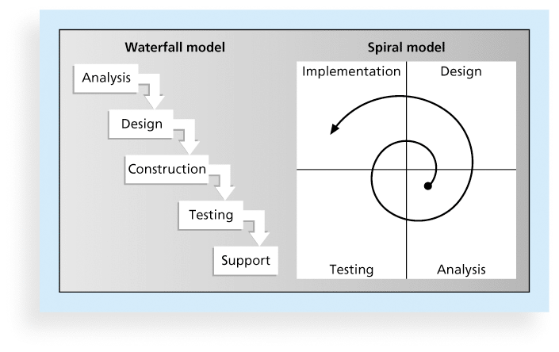
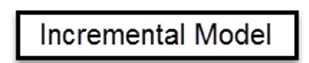
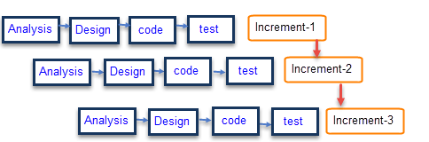
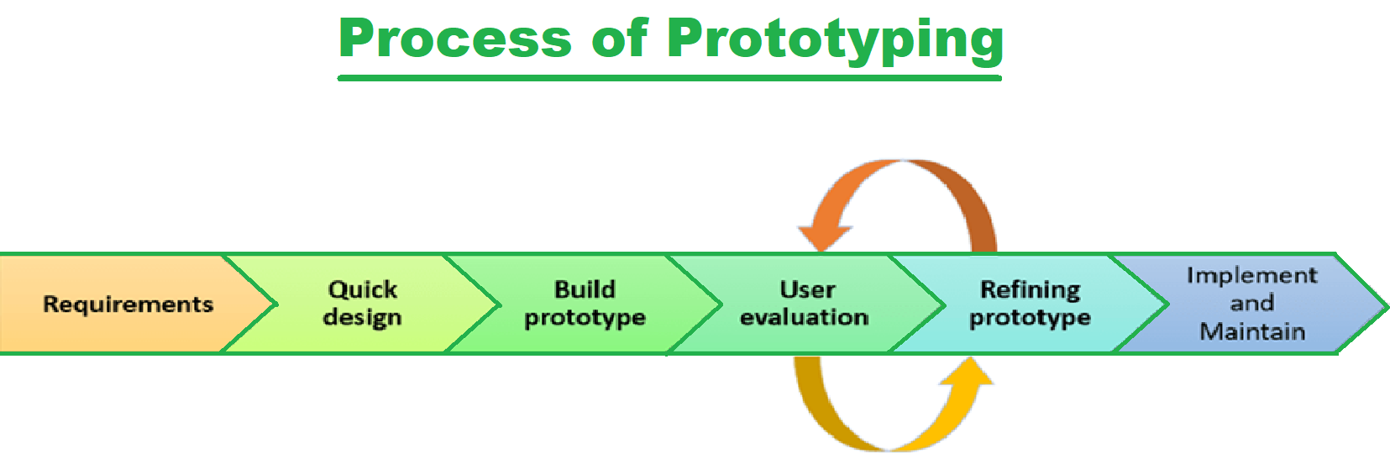
Product Life Cycles
The Systems Development Life Cycle (SDLC) is a framework for describing the phases involved in developing and maintaining information systems
Systems development projects can follow:
Predictive life cycle: the scope of the project can be clearly articulated, and the schedule and cost can be predicted
Adaptive Software Development (ASD) life cycle: requirements cannot be clearly expressed, projects are mission driven and component based, using time-based cycles to meet target dates
Predictive Life Cycle Models:
Waterfall model
Spiral model
Incremental build model
Prototyping model
Rapid Application Development (RAD) model

Slide 18
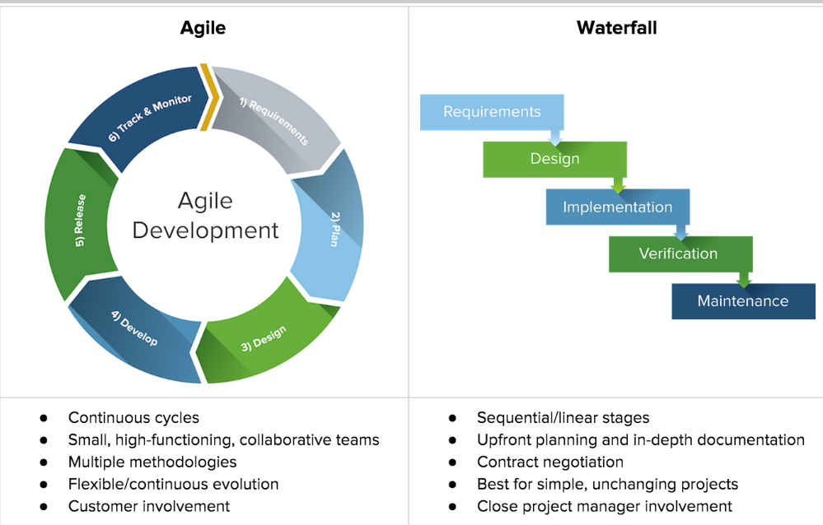
Agile Software Development
Agile software development has become popular to describe new approaches that focus on close collaboration between programming teams and business experts

Slide 19
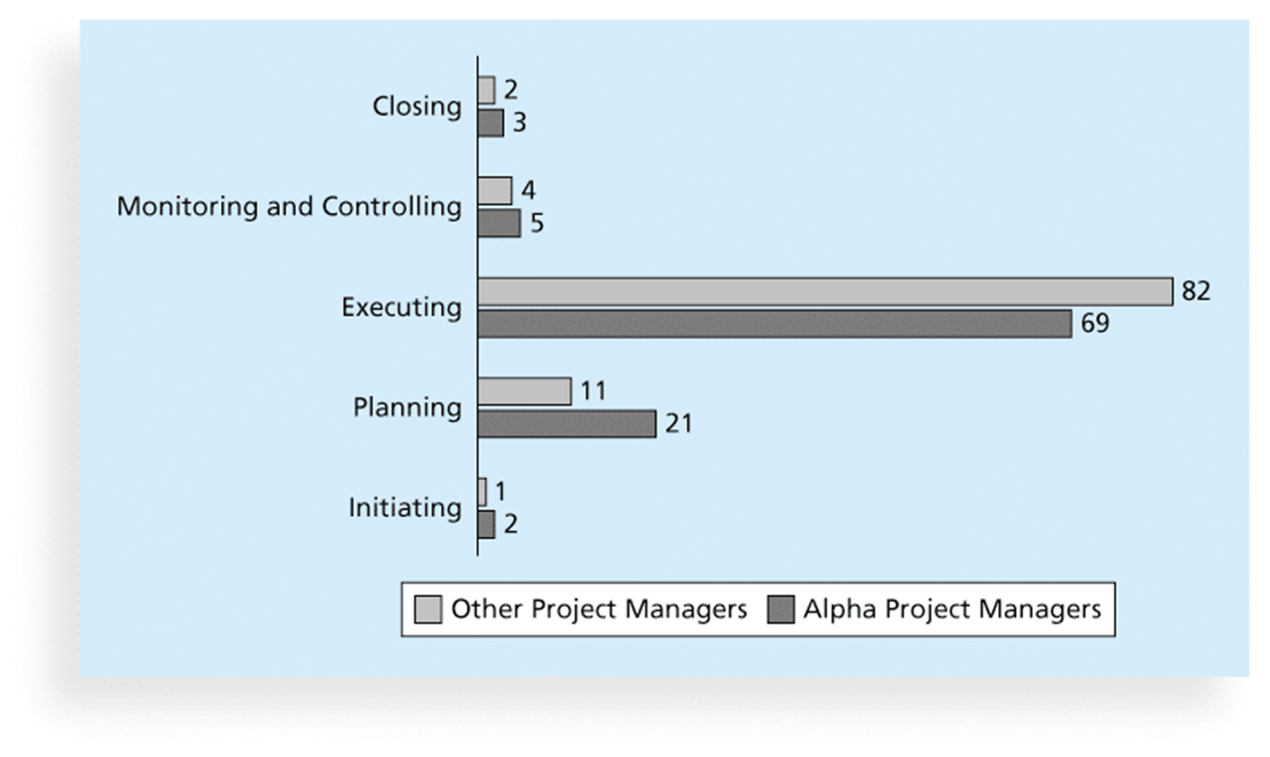
Project Management Process Groups
A process is a series of actions directed toward a particular result
Project management can be viewed as several interlinked processes
The project management process groups include
initiating processes
planning processes
executing processes
monitoring and controlling processes
closing processes

Slide 20
The project management process groups
Project Initiation :
Initiating a project includes recognizing and starting a new project or project phase
The main goal is to formally select and start off projects
Project Planning :
The main purpose of project planning is to guide execution
Every knowledge area includes planning
Project Executing :
Usually takes the most time and resources to perform project execution
Project managers must use their leadership skills to handle the many challenges that occur during project execution
Project Monitoring and Controlling:
Involves measuring progress toward project objectives, monitoring deviation from the plan, and taking correction actions
Affects all other process groups and occurs during all phases of the project life cycle
Outputs include performance reports, change requests, and updates to various plans
Project Closing :
Involves gaining stakeholder and customer acceptance of the final products and services
Even if projects are not completed, they should be closed out to learn from the past
Outputs include project files and lessons-learned reports, part of organizational process assets
Most projects also include a final report and presentation to the sponsor/senior management

Slide 21
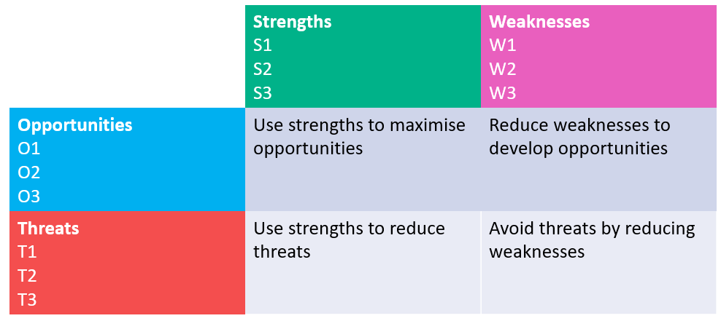
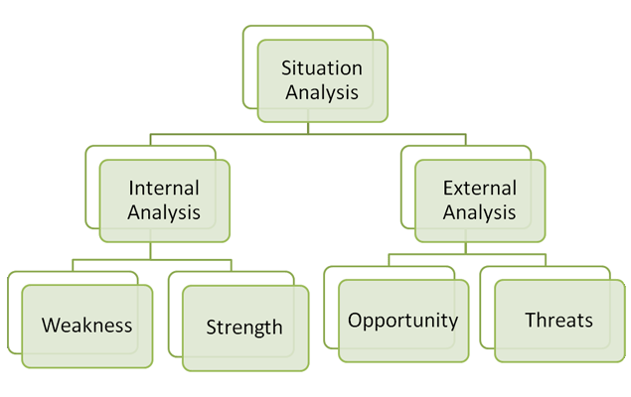
project integration management
Project integration management involves coordinating all elements of a project, including tasks, resources, stakeholders, and deliverables. The purpose of project integration management is to ensure that processes run efficiently and meet predefined goals.
Strategic Planning :
Strategic planning involves determining long-term objectives, predicting future trends, and projecting the need for new products and services
Organizations often perform a SWOT analysis
analyzing Strengths, Weaknesses, Opportunities, and Threats
As part of strategic planning, organizations
identify potential projects
use realistic methods to select which projects to work on
formalize project initiation by issuing a project charter

Slide 22
Project Selection
Methods for selecting projects include:
focusing on broad organizational needs
categorizing information technology projects
performing net present value or other financial analyses

Slide 23
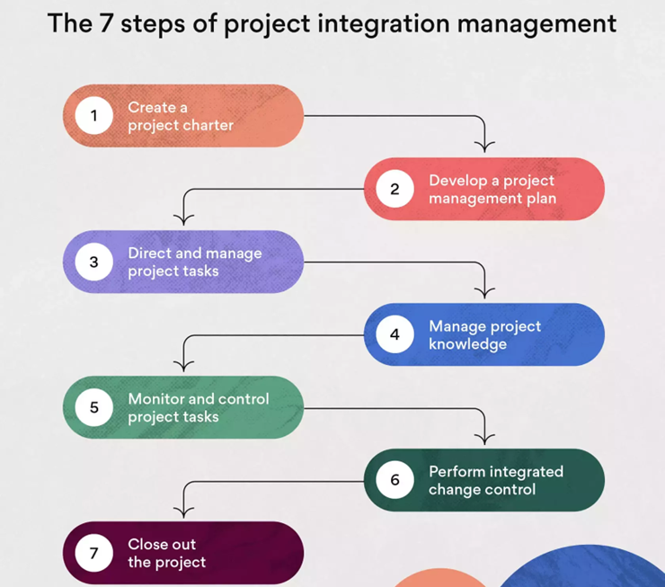
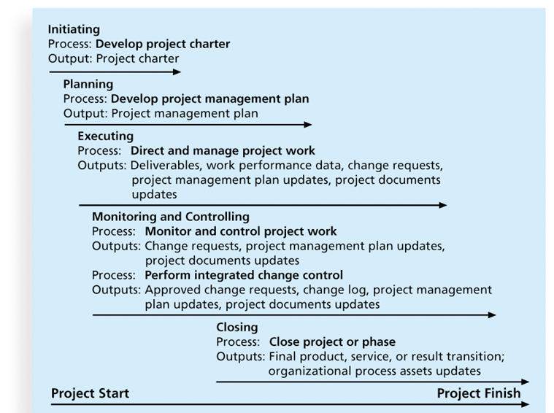
Project Integration Management Processes

Slide 24
Project Integration Management Processes
1. Develop Project Charter :
A project charter is a document that defines the objectives, scope, and stakeholders of a project, providing a roadmap for the team to follow.
Key project stakeholders should sign a project charter to acknowledge agreement on the need and intent of the project.
Steps to writing a Project Charter :
Choose a Project Name
Identify the Purpose, Objective, and Project Specification
Set a Budget
Define Deliverables
Assess Scope and Risks
Create a Timeframe or Milestones
List Key Stakeholders
Layout Team Roles and Responsibilities

Slide 25
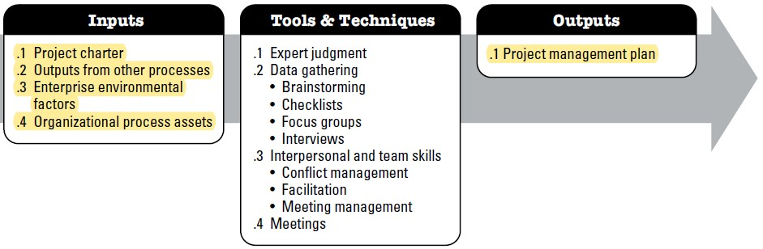
Project Integration Management Processes
2. Develop a Project Management Plan:
Process of defining, preparing, and coordinating all subsidiary plans and integrating them into a comprehensive project management plan.

Slide 26
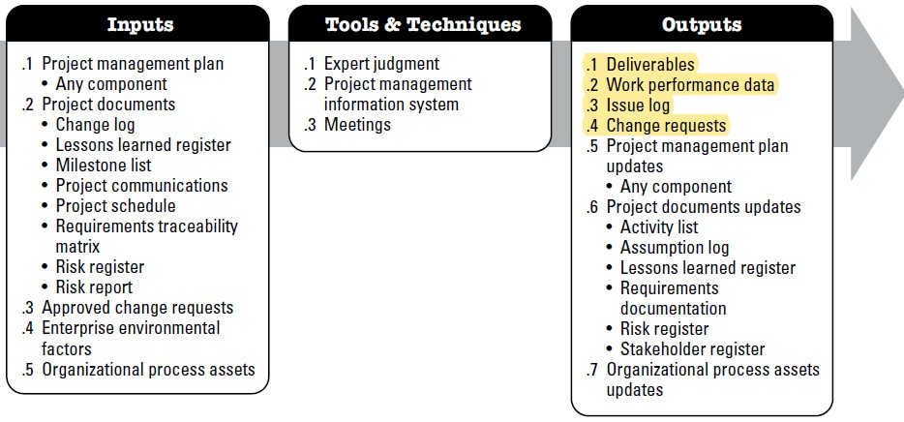
Project Integration Management Processes
3. Directing and Managing Project Work:
Process of leading and performing the work defined in the project management plan and implementing approved changes to achieve the project’s objectives.

Slide 27
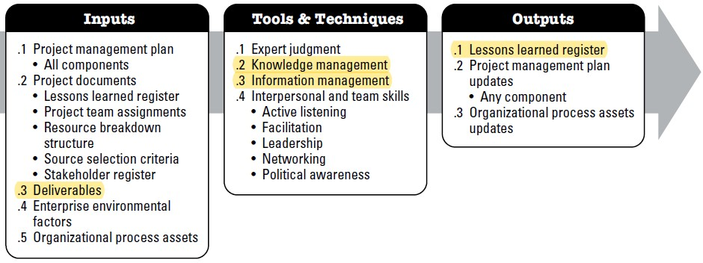
Project Integration Management Processes
4. Manage Project Knowledge:
The process of using existing knowledge and creating new knowledge to support organizational operations and future projects or phases.

Slide 28
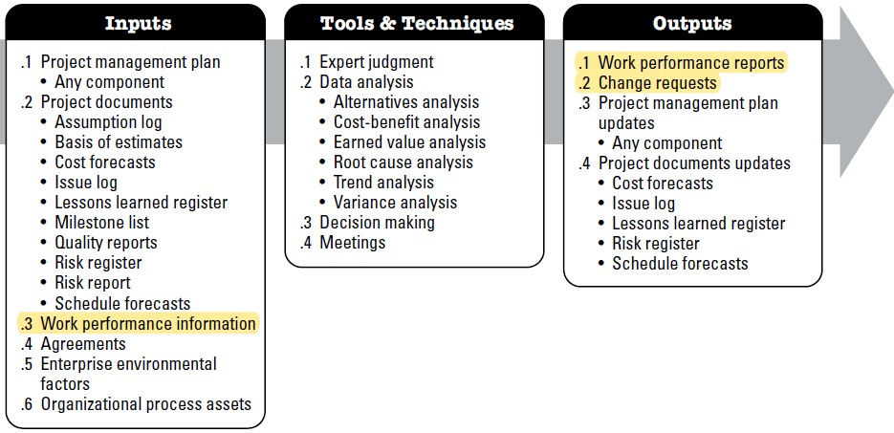
Project Integration Management Processes
5. Monitor & Control Project Work :
The process of tracking, reviewing, and reporting the progress to meet the performance objectives defined in the project management plan.

Slide 29
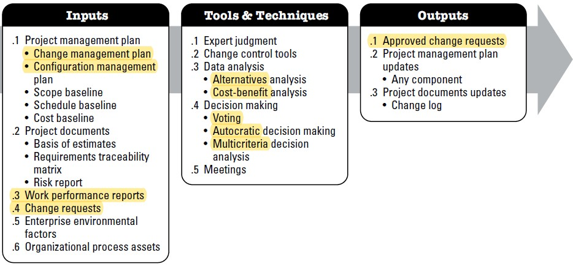
Project Integration Management Processes
6. Perform Integrated Change Control:
Reviewing all change requests; Approving/Rejecting changes. The key benefit of this process is that it allows for documented changes within the project to be considered in addressing overall project risk. This process is performed throughout the project.

Slide 30
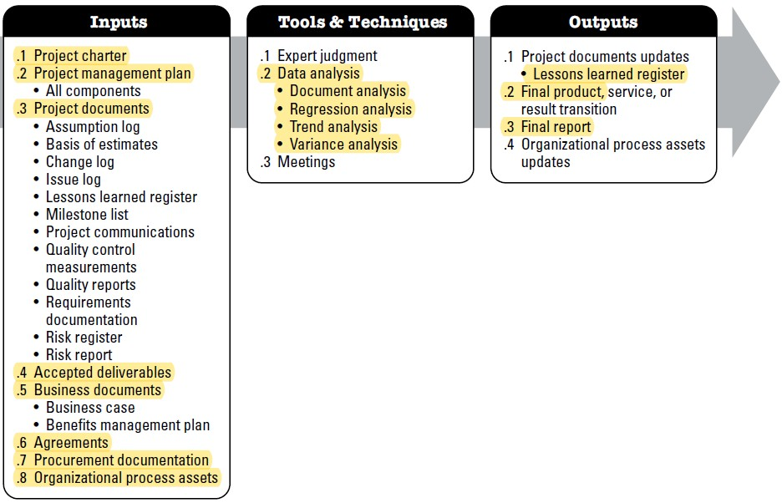
Project Integration Management Processes
7. Closing Projects or Phases:
To close a project or phase, you must finalize all activities and transfer the completed or cancelled work to the appropriate people

Slide 31
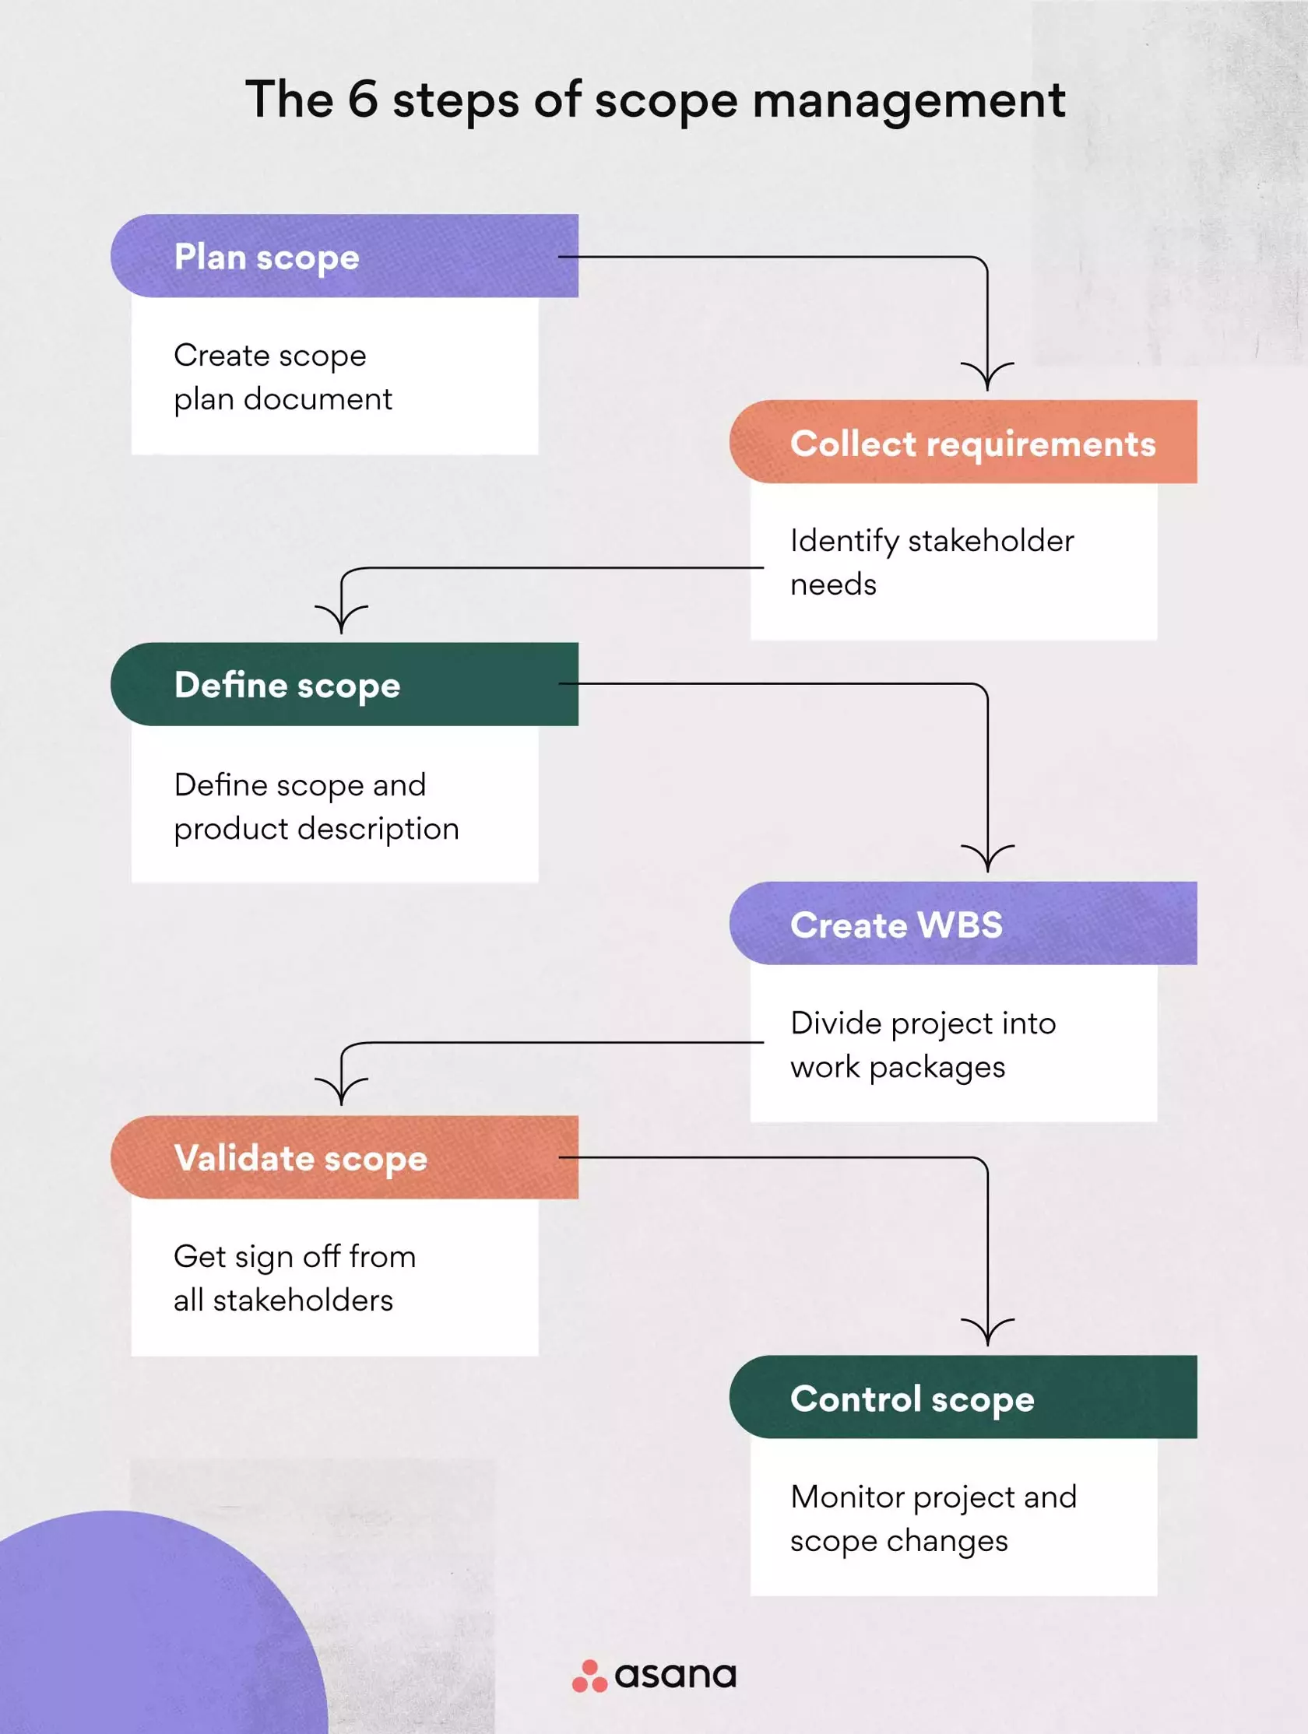
Project Scope Management
Scope refers to all the work involved in creating the products of the project and the processes used to create them
A deliverable is a product produced as part of a project, such as hardware or software, planning documents, or meeting minutes
Project scope management includes the processes involved in defining and controlling what is or is not included in a project

Slide 32
Project Scope Management Processes
Planning scope: determining how the project’s scope and requirements will be managed
Collecting requirements: defining and documenting the features and functions of the products produced during the project as well as the processes used for creating them
Defining scope: reviewing the project charter, requirements documents, and organizational process assets to create a scope statement
Creating the WBS: subdividing the major project deliverables into smaller, more manageable components
Validating scope: formalizing acceptance of the project deliverables
Controlling scope: controlling changes to project scope throughout the life of the project
Notes:
Work Breakdown Structure (WBS)
Variance is the difference between planned and actual performance

Slide 33
Approaches to Developing WBSs
The analogy approach: Review WBSs of similar projects and tailor to your project
The top-down approach: Start with the largest items of the project and break them down
The bottom-up approach: Start with the specific tasks and roll them up
Mind-mapping approach: Mind mapping is a technique that uses branches radiating out from a core idea to structure thoughts and ideas
A WBS dictionary is a document that describes detailed information about each WBS item

Slide 34
Best Practices for Avoiding Scope Problems
1. Keep the scope realistic. Break large projects down into a series of smaller ones
2. Involve users in project scope management.
3. Use off-the-shelf hardware and software whenever possible.
4. Follow good project management processes.

Slide 35
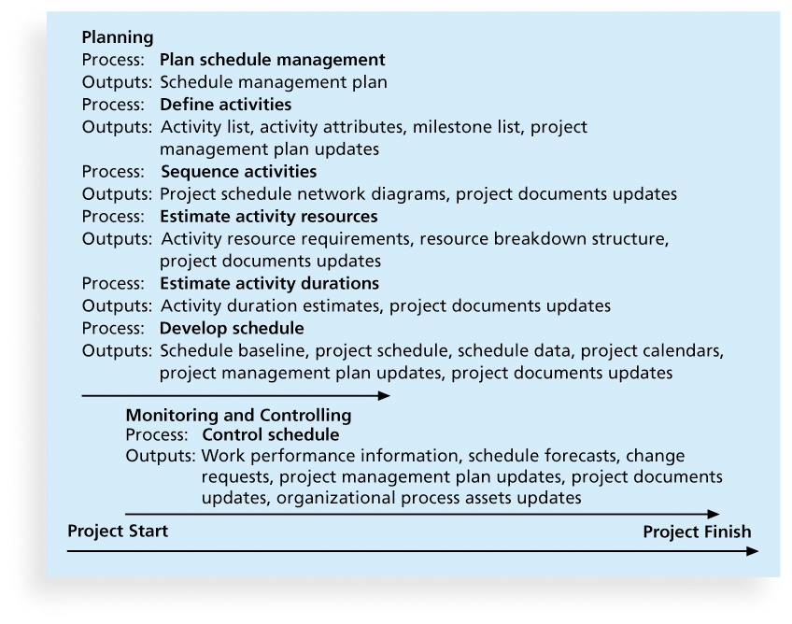
What Is Project Time Management?
Project time management is the project management process of analyzing work and developing a timeline to ensure you complete a project within a particular schedule.
Project Time Management Processes:
Planning schedule management: determining the policies, procedures, and documentation that will be used for planning, executing, and controlling the project schedule
Defining activities: identifying the specific activities that the project team members and stakeholders must perform to produce the project deliverables
Sequencing activities: identifying and documenting the relationships between project activities
Estimating activity resources: estimating how many resources a project team should use to perform project activities
Estimating activity durations: estimating the number of work periods that are needed to complete individual activities
Developing the schedule: analyzing activity sequences, activity resource estimates, and activity duration estimates to create the project schedule
Controlling the schedule: controlling and managing changes to the project schedule

Slide 36
Notes of Project Time Management Processes
A milestone is a significant event that normally has no duration
It often takes several activities and a lot of work to complete a milestone
Examples include obtaining customer sign-off on key documents or completion of specific products
A dependency or relationship is the sequencing of project activities or tasks
You must determine dependencies in order to use critical path analysis
types of Dependencies:
Mandatory dependencies: inherent in the nature of the work being performed on a project, sometimes referred to as hard logic
Discretionary dependencies: defined by the project team, sometimes referred to as soft logic and should be used with care since they may limit later scheduling options
External dependencies: involve relationships between project and non-project activities

Slide 37
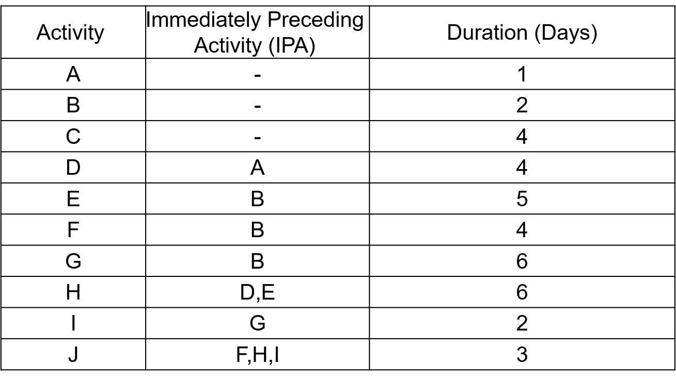
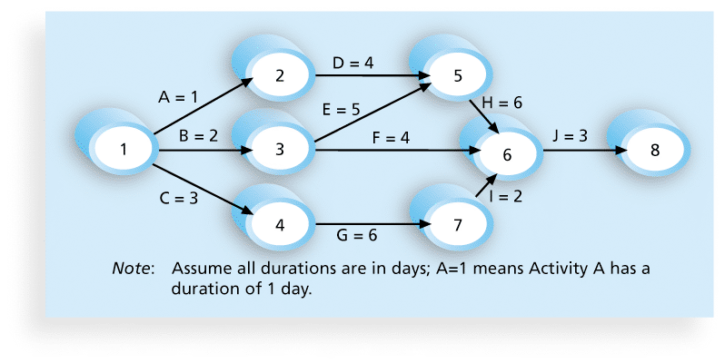
Network Diagrams
Network diagrams are the preferred technique for showing activity sequencing
A network diagram is a schematic display of the logical relationships among, or sequencing of, project activities
Two main formats are the arrow and precedence diagramming methods

Slide 38
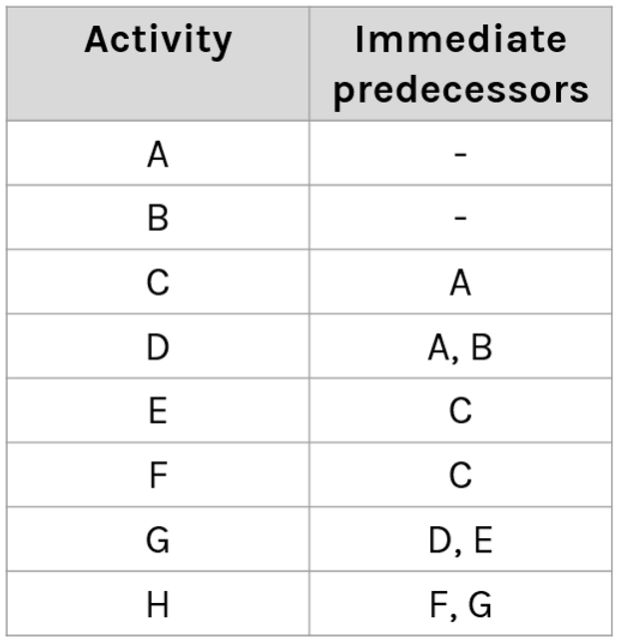
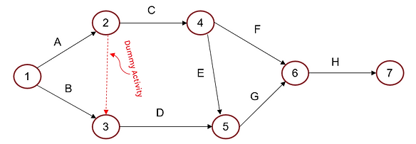
Arrow Diagramming Method (ADM)
Also called activity-on-arrow (AOA) network diagrams
Activities are represented by arrows
Nodes or circles are the starting and ending points of activities
Can only show finish-to-start dependencies
Notes:
Dummy duration = 0

Slide 39
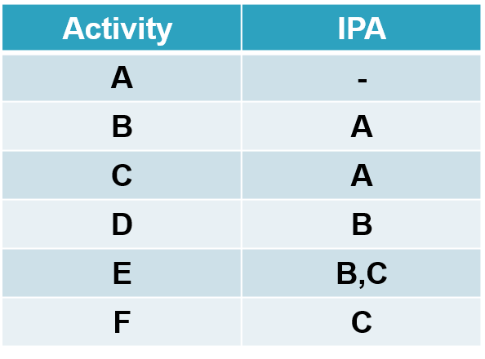
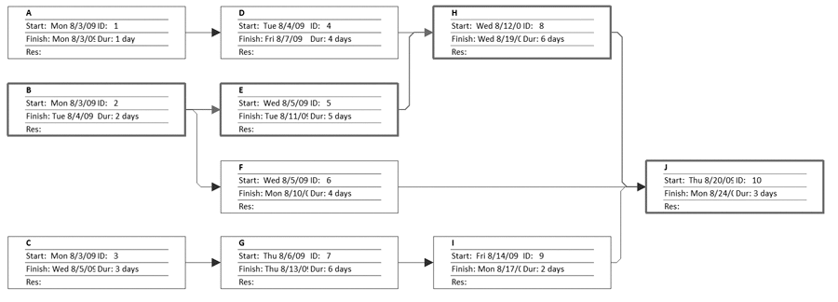
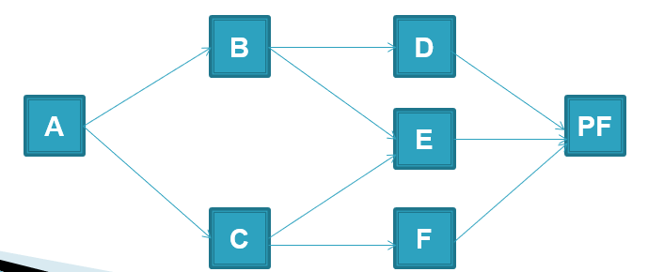
Precedence Diagramming Method (PDM)
Activities are represented by boxes
Arrows show relationships between activities
More popular than ADM method and used by project management software
Better at showing different types of dependencies
arrow network
Sample PDM Network

Slide 40
Cont. Notes
Resources are people, equipment, and materials
A resource breakdown structure is a hierarchical structure that identifies the project’s resources by category and type
Duration includes the actual amount of time worked on an activity plus elapsed time
Effort is the number of workdays or work hours required to complete a task
Important tools and techniques include Gantt charts, critical path analysis, and critical chain scheduling, and PERT analysis
Notes:
The Resource Breakdown Structure (RBS) is a hierarchical chart or diagram that breaks down a project's resources by category and organizes them in a logical and structured manner. The RBS is a tool used in project management to help plan and manage the resources needed to complete a project.
The RBS typically starts with the major categories of resources needed for a project, such as labor, equipment, materials, and facilities. Each category is then further broken down into subcategories, which may be based on the type of resource, the location where it will be used, or other relevant factors.
For example, under the category of labor, the RBS might include subcategories such as project management, engineering, construction, and administrative support. Each of these subcategories could then be further broken down into specific job roles or functions.
By breaking down resources in this way, the RBS helps project managers identify the specific resources needed for each part of the project and allocate them appropriately. It also provides a framework for tracking and managing resource usage throughout the project's lifecycle.
The RBS is often used in conjunction with other project management tools, such as the Work Breakdown Structure (WBS), which breaks down the project into smaller, more manageable tasks. Together, the RBS and WBS provide a comprehensive view of the project's resource needs and help ensure that the project is completed on time, within budget, and to the required quality standards.

Slide 41
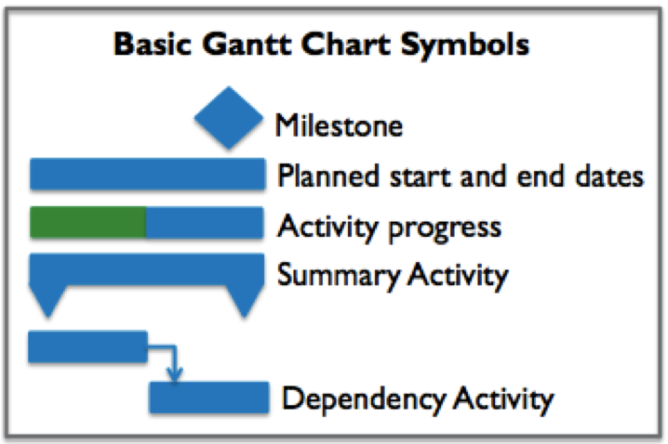
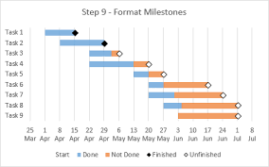
Tools for Developing the schedule
Gantt charts provide a standard format for displaying project schedule information by listing project activities and their corresponding start and finish dates in a calendar format
Symbols include:
A black diamond: a milestones
Thick black bars: summary tasks
Lighter horizontal bars: durations of tasks
Arrows: dependencies between tasks
CPM is a network diagramming technique used to predict total project duration
A critical path for a project is the series of activities that determines the earliest time by which the project can be completed
The critical path is the longest path through the network diagram
Calculate critical path :
First develop a good network diagram
Add the duration estimates for all activities on each path through the network diagram
The longest path is the critical path
If one or more of the activities on the critical path takes longer than planned, the whole project schedule will slip unless the project manager takes corrective action

Slide 42
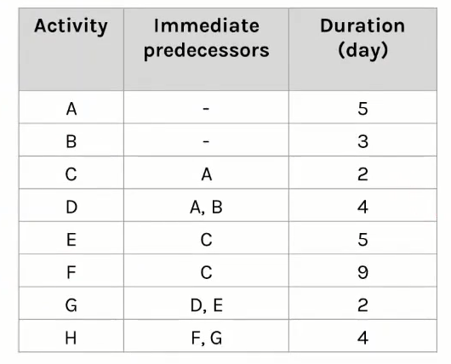
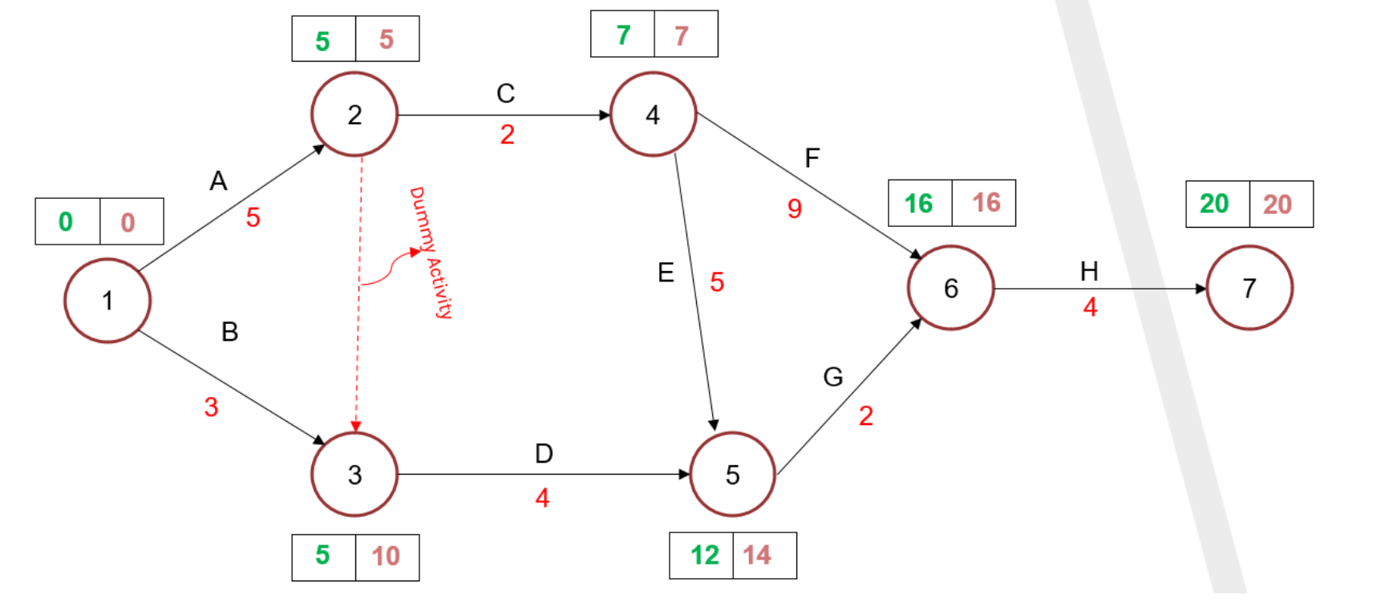
Example on Calculating CP
s

Slide 43
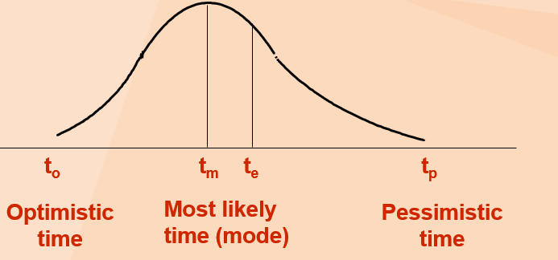
Cont. Tools for Developing the schedule
Program Evaluation and Review Technique (PERT):
PERT is a network analysis technique used to estimate project duration when there is a high degree of uncertainty about the individual activity duration estimates
PERT uses probabilistic time estimates
duration estimates based on using optimistic, most likely, and pessimistic estimates of activity durations, or a three-point estimate
Expected Time:
t_{e} = expected time, t_{o} = optimistic time, t_{m} = most likely time ,
t_{p} = pessimistic time
t_{o} + 4t_{m} +t_{p} 6
t_{e}
=
Notes:
See examples

Slide 44
Example of pert
T_{abc} = 10.0 T_{def} = 16.0 T_{ghi} = 13.50
Optimistic
time
Most likely
time
Pessimistic
time
4.00
b
2-4-6
b
3.17
c
2-3-5
c
2.83
a
1-3-4
a
4.00
d
5.0
e
7.0
f
3-4-5
d
3-5-7
e
5-7-9
f
3.33
g
4.17
i
2-3-6
g
3-4-6
i
6.0
h
4-6-8
h

Slide 45
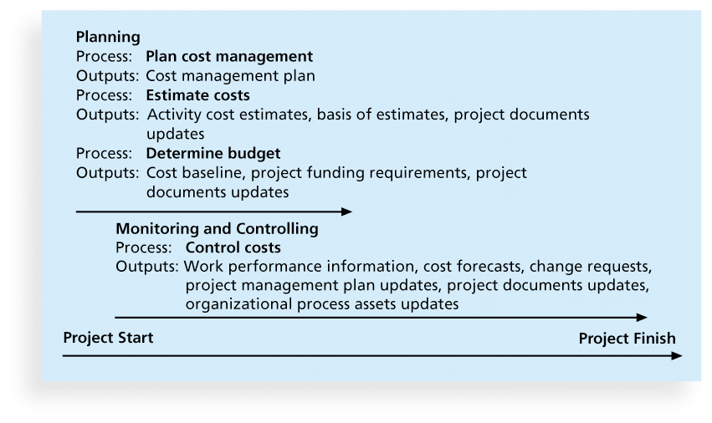
What is Cost and Project Cost Management?
Cost is a resource required to achieve a specific objective or something given up in exchange
Costs are usually measured in monetary units like dollars $
Project cost management includes the processes required to ensure that the project is completed within an approved budget
Project Cost Management Processes:
Planning cost management :determining the policies, procedures, and documentation that will be used for planning, executing, and controlling project cost.
Estimating costs: developing an approximation or estimate of the costs of the resources needed to complete a project
Determining the budget: allocating the overall cost estimate to individual work items to establish a baseline for measuring performance
Controlling costs: controlling changes to the project budget

Slide 46
Basic Principles of Cost Management
Profits are revenues minus expenditures
Profit margin is the ratio of revenues to profits
Life cycle costing considers the total cost of ownership, or development plus support costs for a project
Cash flow analysis determines the estimated annual costs and benefits for a project and the resulting annual cash flow
Elements of cost estimation in project management:
Labor: The cost of team members working on the project, both in terms of wages and time
Materials and equipment: The cost of resources required for the project, from physical tools to software to legal permits
Facilities: The cost of using any working spaces not owned by the organization.
Vendors: The cost of hiring third-party vendors or contractors.
Risk: The cost of any contingency plans implemented to reduce risk.

Slide 47
Notes for Project Cost Management Processes:
Basic tools and techniques for cost estimates:
Analogous or top-down estimates: use the actual cost of a previous, similar project as the basis for estimating the cost of the current project
Bottom-up estimates: involve estimating individual work items or activities and summing them to get a project total
Parametric modeling uses project characteristics (parameters) in a mathematical model to estimate project costs
If possible, estimate costs by major WBS categories
Important goal is to produce a cost baseline (when Determining the Budget)
a time-phased budget that project managers use to measure and monitor cost performance

Slide 48
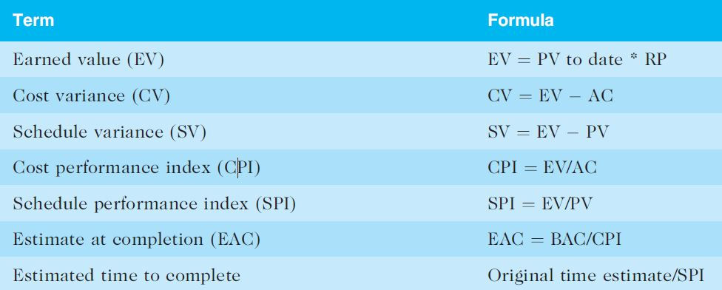
Earned Value Management Terms
The planned value (PV), formerly called the budgeted cost of work scheduled (BCWS), also called the budget, is that portion of the approved total cost estimate planned to be spent on an activity during a given period
Actual cost (AC), formerly called actual cost of work performed (ACWP), is the total of direct and indirect costs incurred in accomplishing work on an activity during a given period
The earned value (EV), formerly called the budgeted cost of work performed (BCWP), is an estimate of the value of the physical work completed
EV is based on the original planned costs for the project or activity and the rate at which the team is completing work on the project or activity to date

Slide 49
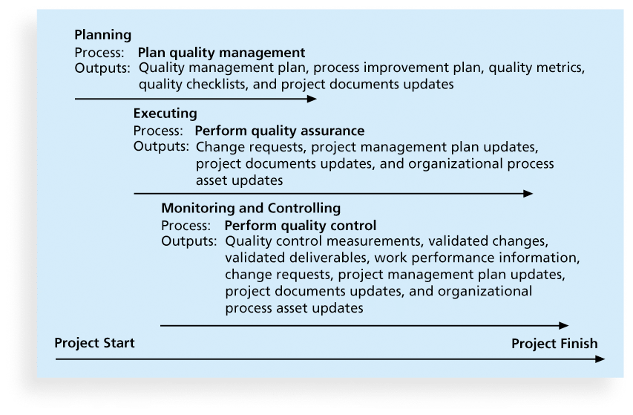
What Is Project Quality Management?
Project quality management ensures that the project will satisfy the needs for which it was undertaken
Processes include:
Planning quality management: Identifying which quality standards are relevant to the project and how to satisfy them; a metric is a standard of measurement
Performing quality assurance: Periodically evaluating overall project performance to ensure the project will satisfy the relevant quality standards
Performing quality control: Monitoring specific project results to ensure that they comply with the relevant quality standards

Slide 50
Notes for Quality Management
Benchmarking generates ideas for quality improvements by comparing specific project practices or product characteristics to those of other projects or products within or outside the performing organization
A quality audit is a structured review of specific quality management activities that help identify lessons learned that could improve performance on current or future projects
Another goal of quality assurance is continuous quality improvement
The main outputs of quality control are:
Acceptance decisions
Rework
Process adjustments

Slide 51
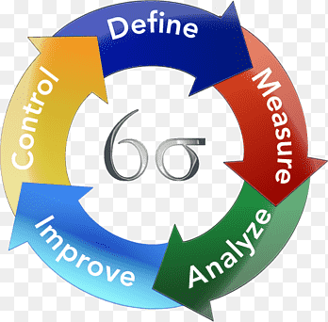
Six Sigma
A Metric that demonstrates quality levels at 99.9997% performance for products and processes.
The target for perfection is the achievement of no more than 3.4 defects per million opportunities
Six Sigma projects normally follow a five-phase improvement process called DMAIC
DMAIC stands for:
Define: Define the problem, process, and customer requirements
Measure: Define measures, then collect, compile, and display data
Analyze: Analyze process details to find improvement opportunities
Improve: Generate solutions and ideas for improving the problem
Control: Track and verify the stability of the improvements and the predictability of the solution
Notes:
Yield represents the number of units handled correctly through the process steps
A defect is any instance where the product or service fails to meet customer requirements

Slide 52
Six 9s of Quality
Six 9s of quality is a measure of quality control equal to 1 fault in 1 million opportunities
In the telecommunications industry, it means 99.9999 percent service availability or 30 seconds of down time a year
This level of quality has also been stated as the target goal for the number of errors in a communications circuit, system failures, or errors in lines of code

Slide 53
Testing
Many IT professionals think of testing as a stage that comes near the end of IT product development
Testing should be done during almost every phase of the IT product development life cycle
Types:
Unit testing tests each individual component (often a program) to ensure it is as defect-free as possible
Integration testing occurs between unit and system testing to test functionally grouped components
System testing tests the entire system as one entity
User acceptance testing is an independent test performed by end users prior to accepting the delivered system

Slide 54
Notes
Modern quality management:
Requires customer satisfaction
Prefers prevention to inspection
Recognizes management responsibility for quality
Several suggestions for improving quality for IT projects include:
Establish leadership that promotes quality
Understand the cost of quality
Focus on organizational influences and workplace factors that affect quality
Follow maturity models

Slide 55
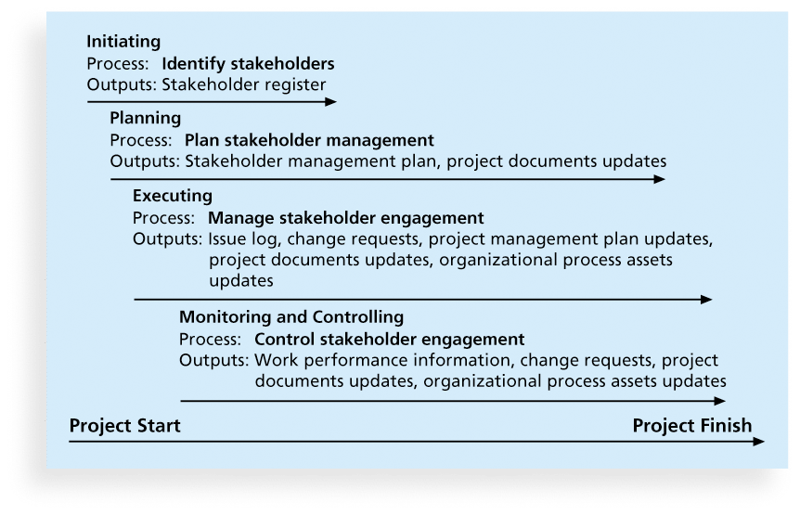
Project Stakeholder Management Processes
Stakeholders
Internal
External
project sponsor
project team
support staff
top managers
customers
Competitors
suppliers
Identifying stakeholders: Identifying everyone involved in the project or affected by it and determining the best ways to manage relationships with them.
Planning stakeholder management: Determining strategies to effectively engage stakeholders
Managing stakeholder engagement: Communicating and working with project stakeholders to satisfy their needs and expectations, resolving issues, and fostering engagement in project decisions and activities
Controlling stakeholder engagement: Monitoring stakeholder relationships and adjusting plans and strategies for engaging stakeholders as needed

Slide 56
Cont.
Stakeholder Engagement Levels
Supportive
Leading
Neutral
Unaware
Resistant
Stakeholder Registration
Identification
Classification
Names
position
location
role
contact information
internal or external
supporter or resistant

Slide 57
Risk Management
Risk is an uncertainty that can have a negative or positive effect on meeting project objectives
Positive risks are risks that result in good things happening
Opportunity: is Positive Risk
Threat: is Negative Risk
Types of Risk:
Schedule
Resource
Budget
Technical
Scope
Environmental

Slide 58
The Importance of Project Risk Management
Project risk management is the art and science of identifying, analyzing, and responding to risk throughout the life of a project and in the best interests of meeting project objectives
The goal of project risk management is to minimize potential negative risks while maximizing potential positive risks

Slide 59
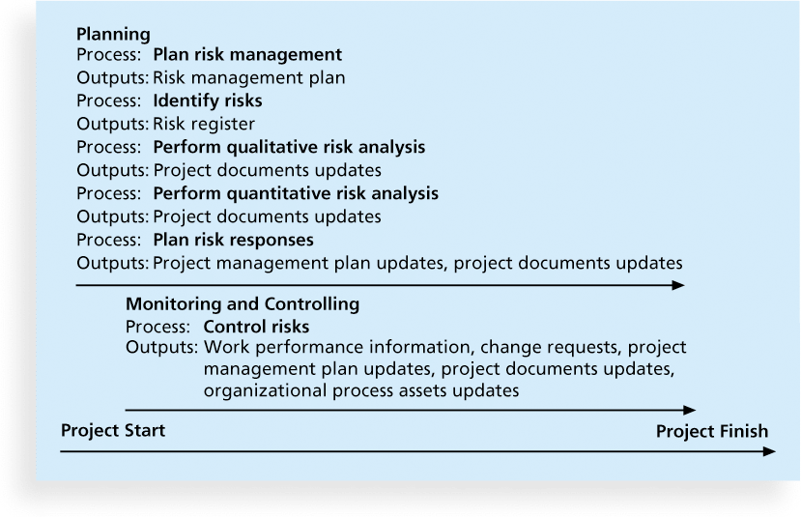
Project Risk Management Processes
Plan Risk Management
Identify Risks
Perform Qualitative Risk Analysis
Perform Quantitative Risk Analysis
Plan Risk Responses
Implement Risk Responses
Monitor Risk
(Planning Process)
(Planning Process)
(Planning Process)
(Planning Process)
(Planning Process)
(Executing Process)
(M&C Process)

Slide 60
Cont. Project Risk Management Processes
Planning risk management : Deciding how to approach and plan the risk management activities for the project
Identifying risks: Determining which risks are likely to affect a project and documenting the characteristics of each
Performing qualitative risk analysis: Prioritizing risks based on their probability and impact of occurrence
Performing quantitative risk analysis: Numerically estimating the effects of risks on project objectives
Planning risk responses: Taking steps to enhance opportunities and reduce threats to meeting project objectives
Controlling risk: Monitoring identified and residual risks, identifying new risks, carrying out risk response plans, and evaluating the effectiveness of risk strategies throughout the life of the project

Slide 61
Note.
Risk Breakdown Structure
A risk breakdown structure (RBS) is a hierarchy of potential risk categories for a project
Like a work breakdown structure but used to identify and categorize risks
Risk identification tools and techniques include:
Brainstorming: is a technique by which a group attempts to generate ideas or find a solution for a specific problem by collecting ideas
The Delphi Technique : is used to derive a consensus among a panel of experts who make predictions about future developments
Interviewing : is a fact-finding technique for collecting information in face-to-face, phone, e-mail, or instant-messaging discussions
SWOT analysis

Slide 62
5 Planning Risk Responses
After identifying and quantifying risks, you must decide how to respond to them
Four main response strategies for negative risks:
Risk avoidance
Risk acceptance
Risk transference
Risk mitigation

Slide 63
6 Controlling Risks
Involves executing the risk management process to respond to risk events and ensuring that risk awareness is an ongoing activity performed by the entire project team throughout the entire project
Main outputs of risk control are:
Work performance information
change requests
updates to the project management plan, other project documents, and organizational process assets

Slide 64
Task
If you are working on selecting a graduation project and you need to write:
1. SWOT Analysis
2. Project Charter (Project Name, Objective, Budget, Deliverables, Stakeholders, Team Roles and Responsibilities, …)
3. Scope statement, RTM, WBS
4. Gantt Chart
5. Cost Estimation
6. Expected Risks

